Slide 1
Probabilistic U-Net for Segmentation of Ambiguous Images
Original Paper: Kohl, Simon A. A., Romera-Paredes, et al. A Probabilistic U-Net for Segmentation of Ambiguous Images. (2019). arxiv:1806.05034 Advances in Neural Information Processing Systems
Presentation author: Krisztina Sinkovics
Venue: nPlan ML Paper Club (virtual)
Date: 30th of August 2020

Slide 2
Task
Learn a distribution of segmentations given an input
On a class of images where the image context alone is not enough to resolve ambiguities
e.g. on medical images:
lesion (anomalous region) ≠ cancer

Slide 3
Problem Setup
Pixel-wise probabilities
The most likely hypothesis
Misdiagnosis, sub-optimal treatment
vs
vs
Covariance between the pixels
Multiple hypothesis
Subsequent tests to resolve multiple ambiguities

Slide 4
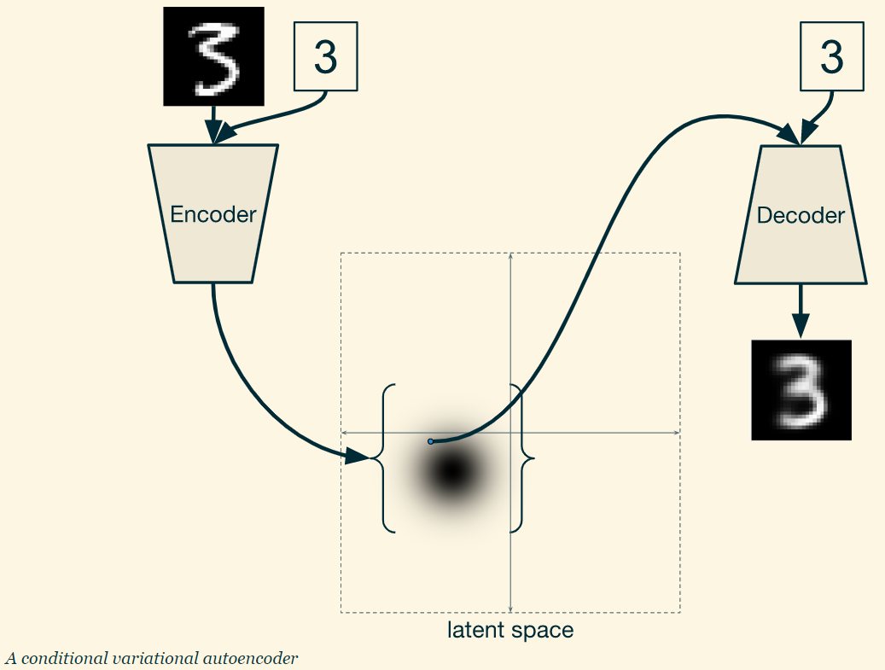
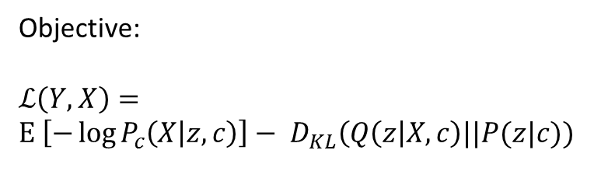
CVAE
Objective:
$$ℒ\left(Y,X\right)=$$
$$Ε_{ }\left[−\log{P_{c}\left(X | z, c\right)}\right]− D_{KL}\left(Q\left(z\right|X,c\right)||P(z|c))$$
Notes:
Source: https://ijdykeman.github.io/ml/2016/12/21/cvae.html?fbclid=IwAR35Bg9fAhCGsF4XekZVwqBW98oxaE2OtfmoWpByNUH8nm7lkSrvmY1j3Tw

Slide 5
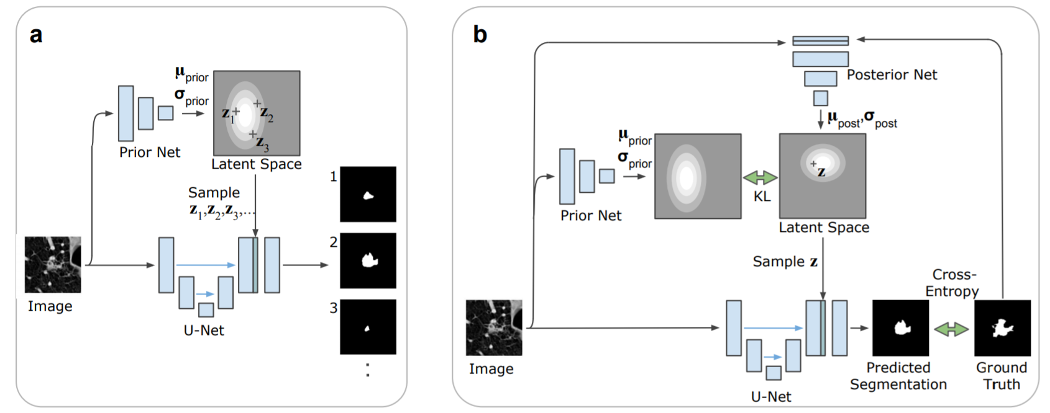
How they do it (U-Net + cVAE)
Figure 1: The Probabilistic U-Net.
Sampling process for inference. Arrows: flow of operations; blue blocks: feature maps. The heatmap represents the probability distribution in the low-dimensional latent space RN (e.g., N = 6 in our experiments). For each execution of the network, one sample z ∈ RN is drawn to predict one segmentation mask. Green block: N-channel feature map from broadcasting sample z. The number of feature map blocks shown is reduced for clarity of presentation.
Training process illustrated for one training example. Green arrows: loss functions.

Slide 6
How others do it
Dropout U-Net
+ Probability distribution using dropout over spatial features → quantified pixel-wise uncertainty
Inconsistent outputs
Ensemble of U-Nets trained separately
+ Consistent outputs
Outputs not diverse
Not able to learn rare variants, only most likely hypotheses
Does not scale well to large # of hypotheses
Need to fix # of hypotheses at training
M-Heads
+ Captures diverse set of variants
But not occurrence of individual variants
Does not scale well to large # of hypotheses
Need to fix # of hypotheses at training
Graphical models (Junction Chains, Markov Random Fields)
+ Captures diverse set of variants
- Confined to structured problems ← tractable graphical models

Slide 7
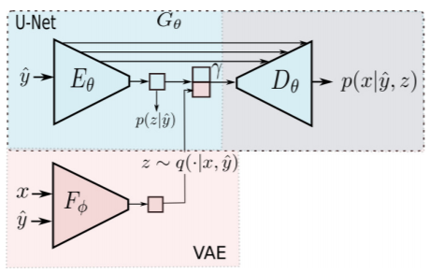
Related work from Image2Image translation
GANs
Suffer from mode collapse
Solved in “bicycleGAN”
CVAE - GAN + Conditional latent regressor GAN
Fixed prior distribution
Posterior only conditioned on output
VAE + U-Net for generating appearances given a shape encoding
Involves pre-trained VGG19 that measures perceptual similarity and feeds into reconstruction loss
Probabilistic model for Structured outputs
Optimizing dissimilarity coefficient between ground truth and predicted distributions
Assessed on hand pose estimation -> predict position on 14 joints

Slide 8
Contributions
Consistent segmentation maps of pixel-wise probabilities → joint likelihood of model
Arbitrarily complex output distributions
Rare modes
Calibrated probabilities of segmentation modes
Computationally cheap sampling
Assessing performance quantitatively

Slide 9
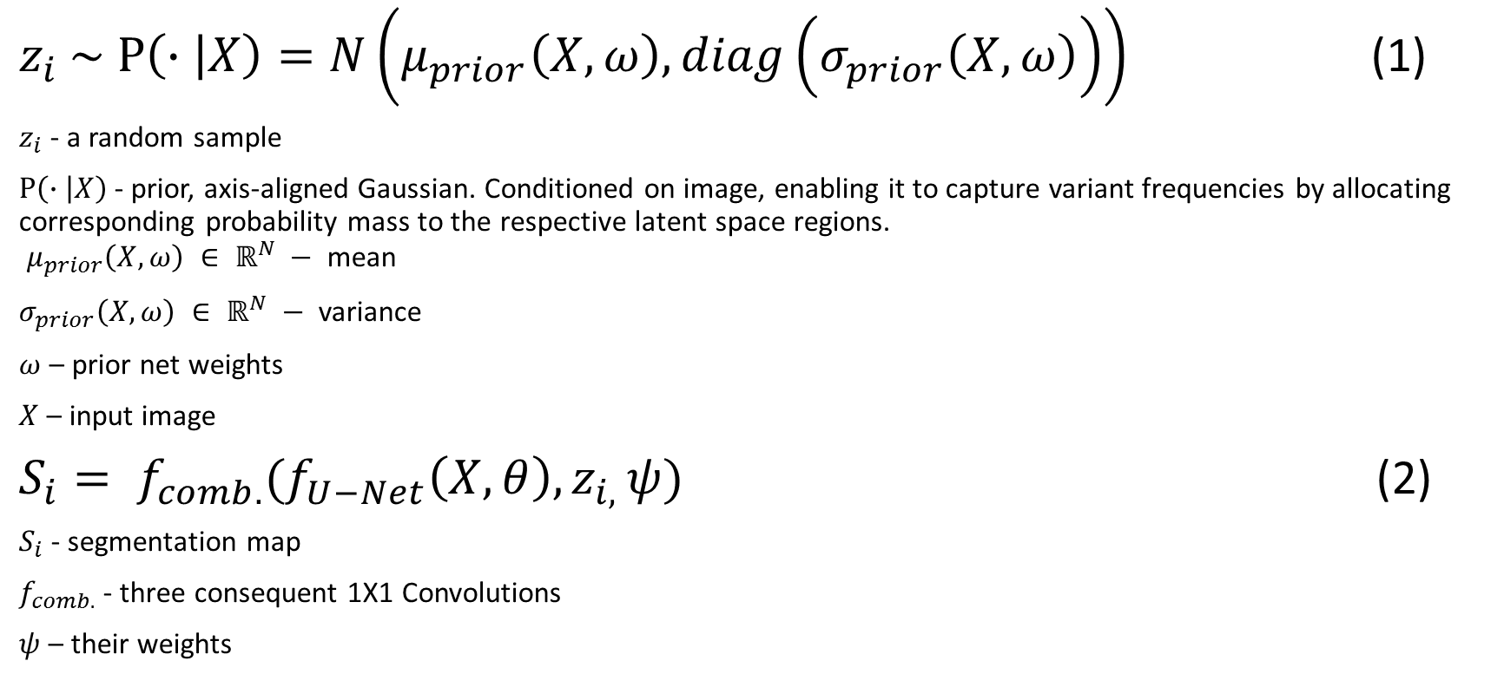
Network Architecture: Sampling for inference (formal explanation to Figure 1. a))
$z_{i} \sim$ $P\left(∙ | X\right)=N\left(μ_{prior}\left(X,ω\right), diag\left(σ_{prior}\left(X,ω\right)\right)\right)$ (1)
$z_{i}$ - a random sample
$P\left(∙ | X\right)$- prior, axis-aligned Gaussian. Conditioned on image, enabling it to capture variant frequencies by allocating corresponding probability mass to the respective latent space regions. $μ_{prior}\left(X,ω\right) ∈ ℝ^{N} −$ mean
$σ_{prior}\left(X,ω\right) ∈ ℝ^{N} −$ variance
$ω$ – prior net weights
$X$ – input image
$S_{i}= f_{comb.}(f_{U−Net}\left(X, θ\right), z_{i, }ψ)$ (2)
$S_{i}$ - segmentation map
$f_{comb.}$ - three consequent 1X1 Convolutions
$ψ$ – their weights

Slide 10
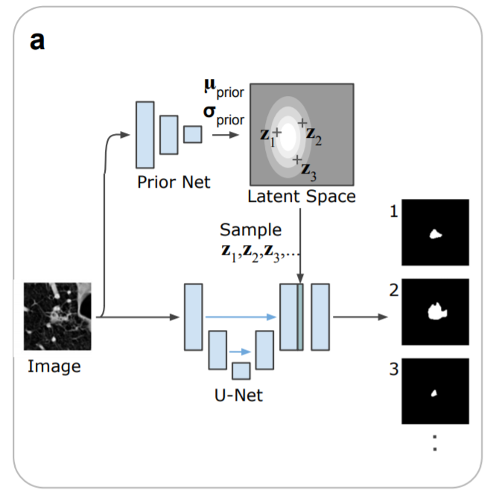








Sampling (for inference) Figure 1. a)
Repeat m times

Slide 11


Sampling (for inference) Figure 1. a)
Repeat m times

Slide 12
Sampling (for inference) Figure 1. a)
Repeat m times

Slide 13
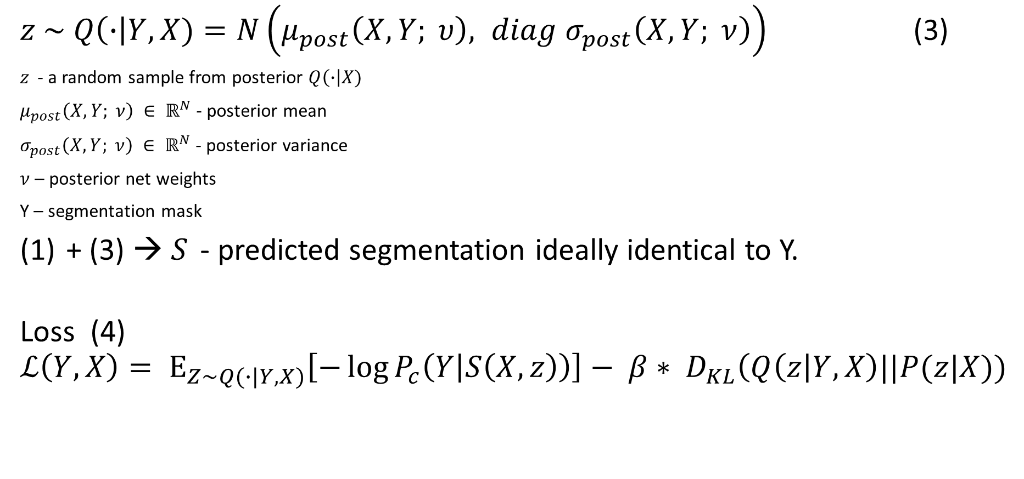
Network Architecture: Training (formal explanation to Figure 1. b))
$z \sim Q\left(∙\right|Y, X)=N\left(μ_{post}\left(X, Y; υ\right), diag{ σ}_{post}\left(X,Y; ν\right)\right)$ (3)
$z_{ }$ - a random sample from posterior $Q\left(∙\right|X)$
$μ_{post}\left(X,Y; ν\right) ∈ ℝ^{N}$ - posterior mean
$σ_{post}\left(X,Y; ν\right) ∈ ℝ^{N}$ - posterior variance
$ν$ – posterior net weights
Y – segmentation mask
+ (3) → $S_{ }$ - predicted segmentation ideally identical to Y.
Loss (4)
$$ℒ\left(Y,X\right)= Ε_{Z\sim Q(∙|Y, X)}\left[−\log{P_{c}\left(Y | S\left(X, z\right)\right)}\right]− β∗ D_{KL}\left(Q\left(z\right|Y, X\right)||P(z|X))$$
– ELBO
Cross-Entropy loss between (S and Y)
Weighting factor
Kullback-Leibler Divergence
between posterior Q and prior P

Slide 14
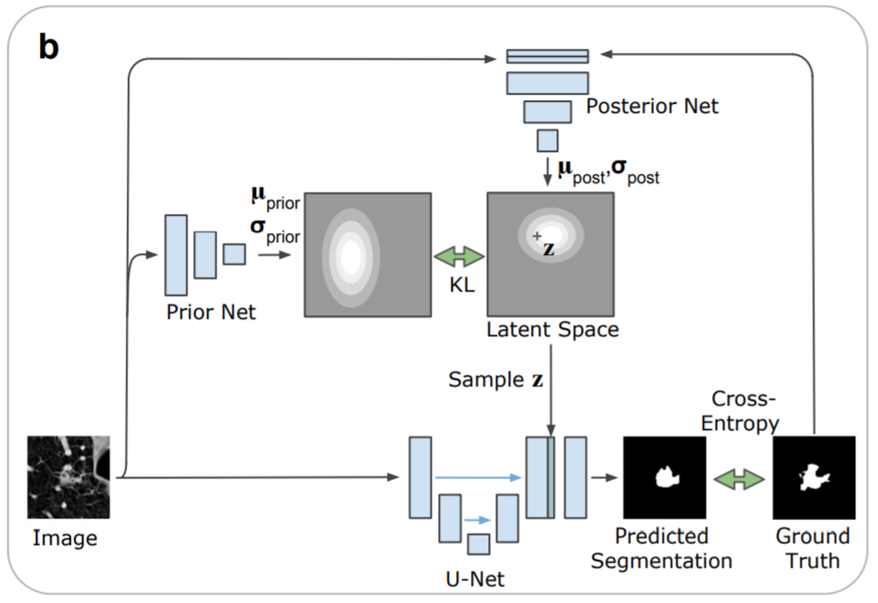
Network Architecture: Training (Figure 1. b)
Conditioned on input X

Slide 15
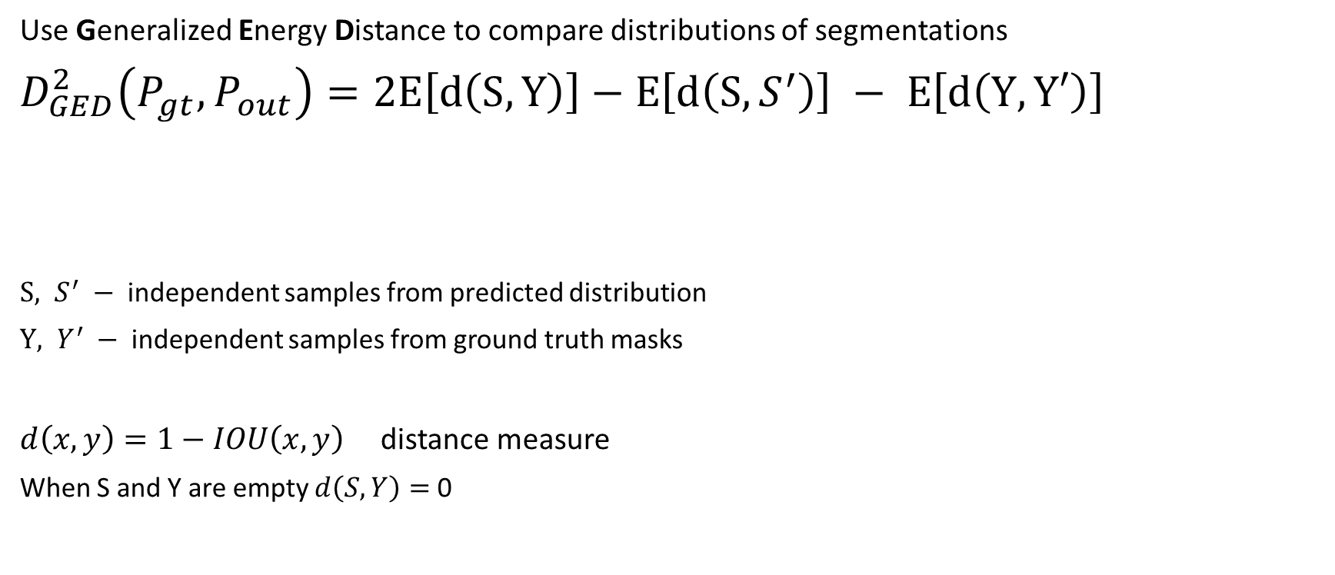
Performance Measures
Use Generalized Energy Distance to compare distributions of segmentations
$D_{GED}^{2}\left(P_{gt}, P_{out}\right)=2Ε\left[d\left(S, Y\right)\right]−Ε\left[d\left(S, S^{′}\right)\right] −$ $Ε\left[d\left(Y, Y′\right)\right]$
$S, S^{′} −$ independent samples from predicted distribution
$Y, Y^{′} −$ independent samples from ground truth masks
$d\left(x, y\right)=1−IOU\left(x,y\right)$ distance measure
When S and Y are empty $d\left(S, Y\right)=$ 0
Disagreement between gt and predicted sample
Disagreement between a pair of predicted masks
Disagreement between a pair of gt masks

Slide 16
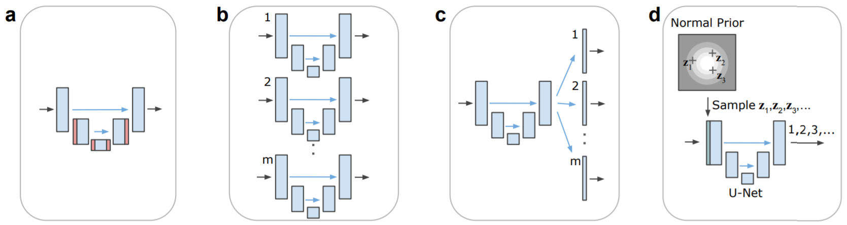
Baseline Methods
Dropout U-Net
U-Net Ensemble
M-Heads
Image2Image VAE
Figure 2: Baseline architectures
Arrows: flow of operations
blue blocks: feature maps
red blocks: feature maps with dropout with probability p=0.5
green block broadcasted latents.
Note that the number of feature map blocks shown is reduced for clarity of presentation.

Slide 17
Results: Lung Abnormalities Segmentation
Setup:
1018 lung CT scans
from 1010 lung patients
For each scan 4 radiologists (from a total of 12) provided annotation masks
Resampled CT scans to 0.5 mm × 0.5 mm in-plane resolution
Cropped 2D images (180 × 180 pixels) centered at the lesion positions
Training set 722 patients 8882 images
Validation set 144 patients 1996 images
Test set 144 patients 1992 images
3 masks per image can be empty as experts can disagree

Slide 18
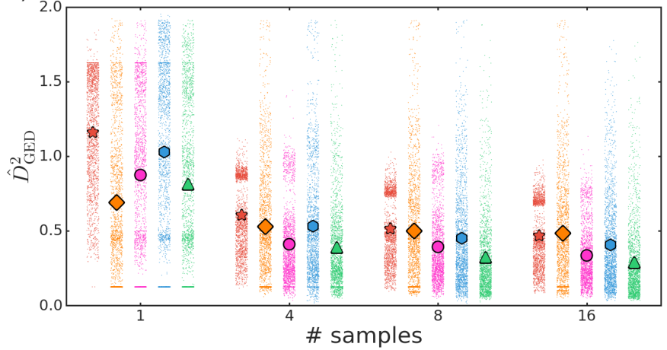

Results: Lung Abnormalities Segmentation
$${\hat{D}}_{GED}^{2}\left(P_{gt}, P_{out}\right)=\frac{2}{nm}\sum_{i=1}^{n}{\sum_{j=1}^{m}{d(S_{i},Y_{j})}}−\frac{1}{n^{2}}\sum_{i=1}^{n}{\sum_{j=1}^{n}{d(S_{i},{S′}_{j})}}−\frac{1}{m^{2}}\sum_{i=1}^{m}{\sum_{j=1}^{m}{d(Y_{i},{Y′}_{j})}}$$
$m$ = 4
$n$= 1, 4, 8, 16

Slide 19
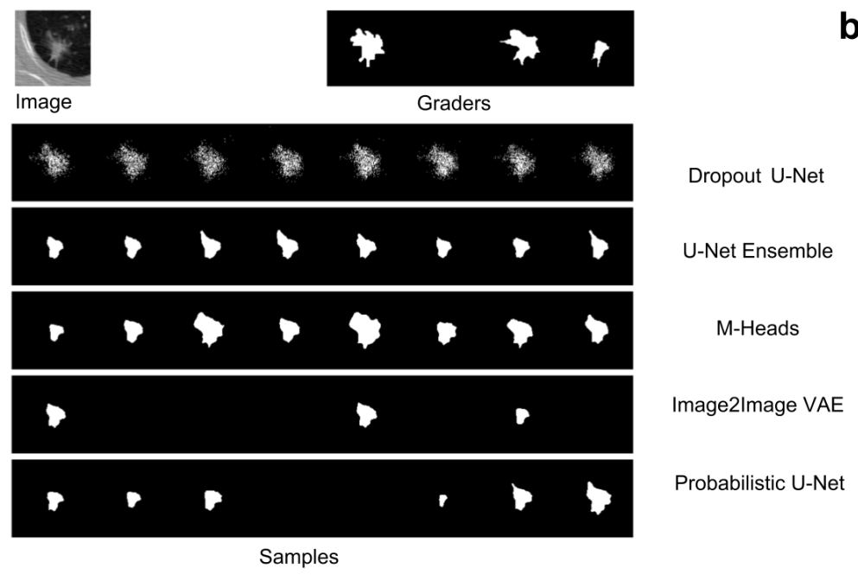
Results: Lung Abnormalities Segmentation
Qualitative

Slide 20
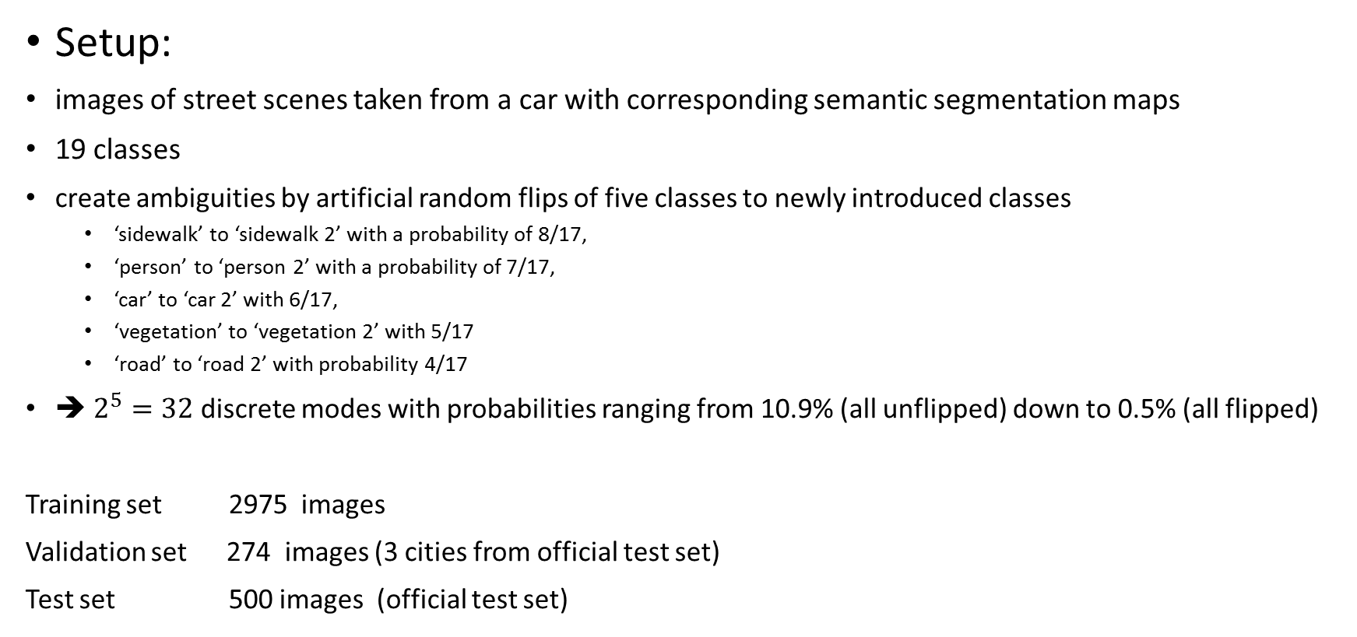
Results: Cityscapes Semantic Segmentation
Setup:
images of street scenes taken from a car with corresponding semantic segmentation maps
19 classes
create ambiguities by artificial random flips of five classes to newly introduced classes
‘sidewalk’ to ‘sidewalk 2’ with a probability of 8/17,
‘person’ to ‘person 2’ with a probability of 7/17,
‘car’ to ‘car 2’ with 6/17,
‘vegetation’ to ‘vegetation 2’ with 5/17
‘road’ to ‘road 2’ with probability 4/17
➔ $2^{5}=32$ discrete modes with probabilities ranging from 10.9% (all unflipped) down to 0.5% (all flipped)
Training set 2975 images
Validation set 274 images (3 cities from official test set)
Test set 500 images (official test set)

Slide 21
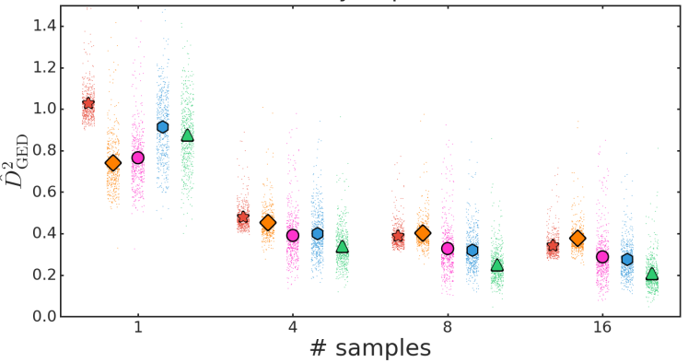

Results: Cityscapes Semantic Segmentation
$${\hat{D}}_{GED}^{2}\left(P_{gt}, P_{out}\right)=\frac{2}{nm}\sum_{i=1}^{n}{\sum_{j=1}^{M}{d(S_{i},Y_{j})}ω_{j}}−\frac{1}{n^{2}}\sum_{i=1}^{n}{\sum_{j=1}^{n}{d\left(S_{i},{S^{′}}_{j}\right)}}−\frac{1}{m^{2}}\sum_{i=1}^{M}{\sum_{j=1}^{M}{d\left(Y_{i},{Y^{′}}_{j}\right)ω_{i}ω_{j}}}$$
$M=32$Dirac delta distributions, used directly in the estimator; $n$= 1, 4, 8, 16;
$ω_{j}$ - weight of the j-th mixture

Slide 22
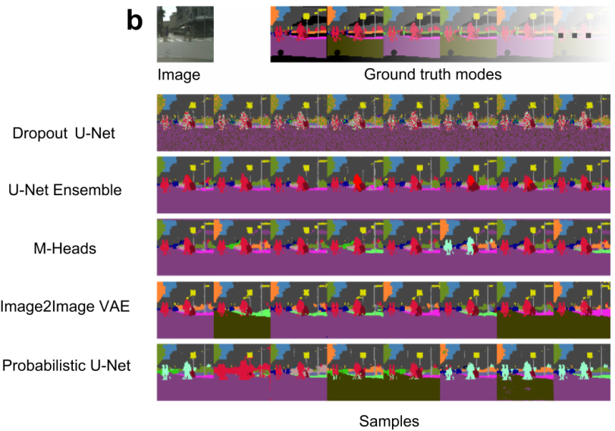

Results: Cityscapes Semantic Segmentation
Qualitative

Slide 23
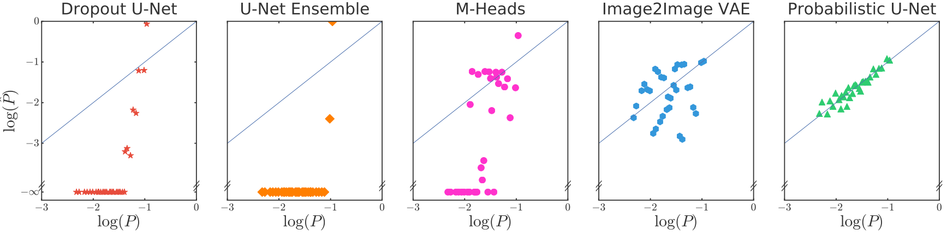
Reproducing segmentation probabilities (Cityscapes)
Figure 5.
The artificial flipping of 5 classes results in 32 modes with different ground truth probability (x-axis). The y-axis shows the frequency of how often the model predicted this variant in the whole test set. Agreement with the bisector line indicates calibration quality.

Slide 24
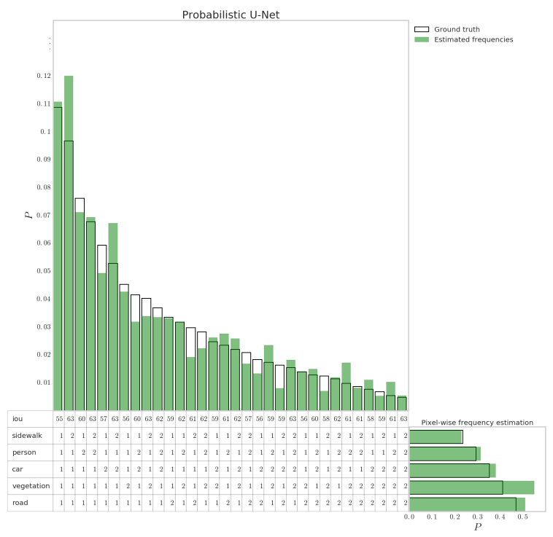
How the model fits ground truth distribution
Figure 10: Reproduction of probabilities by our Probabilistic U-Net.
The vertical histogram shows the mode-wise occurrence frequencies of samples in comparison to the ground-truth probability of the modes, and the horizontal histogram reports the pixel-wise marginal frequencies, i.e. the sampled pixel-fractions for each new stochastic class (e.g. sidewalk 2) with respect to the corresponding existing one (sidewalk)

Slide 25
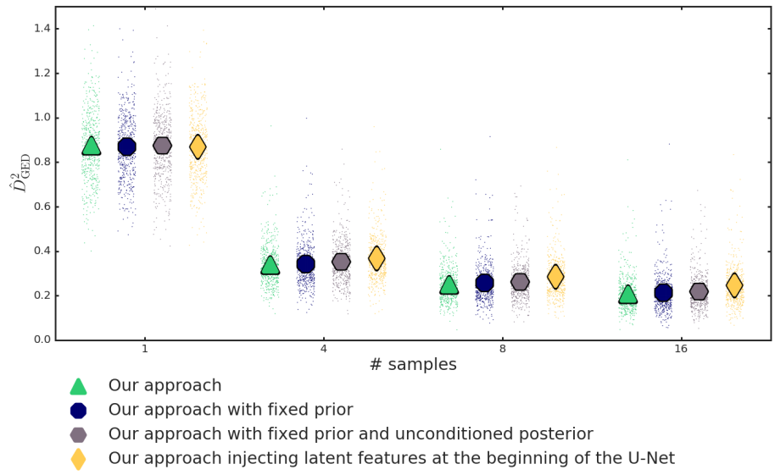
Ablation analysis

Slide 26
Conclusions
Probabilistic U-Net provides consistent segmentation masks that closely match multi-modal gt distributions.
Captures complex output distributions including rare modes.
Outperformed the baselines in 4,8 and 16 sample cases, by a significant (Wilcoxon signed-rank test yielding small p-value) but thin margin.
Disentangles prior and segmentation net , conditioning on the entire image while allowing low computational cost.
Architecture allows to inspect its latent space bc of VAE component.
Experiment setup allows for in-depth performance evaluation.
– More support for the good model calibration claim would be welcome.
– Lack of description behind the choice of architecture components (e.g. why conditioning Prior and Posterior, why training Prior and Posterior networks, why Beta in the Loss).

Slide 27
Thank you!

Slide 28
Interesting posts
Probabilistic U-Net's implementation on github (original)
Background
Conditional Variational Autoencoders
Conditional VAE
Variational Inference

Slide 29
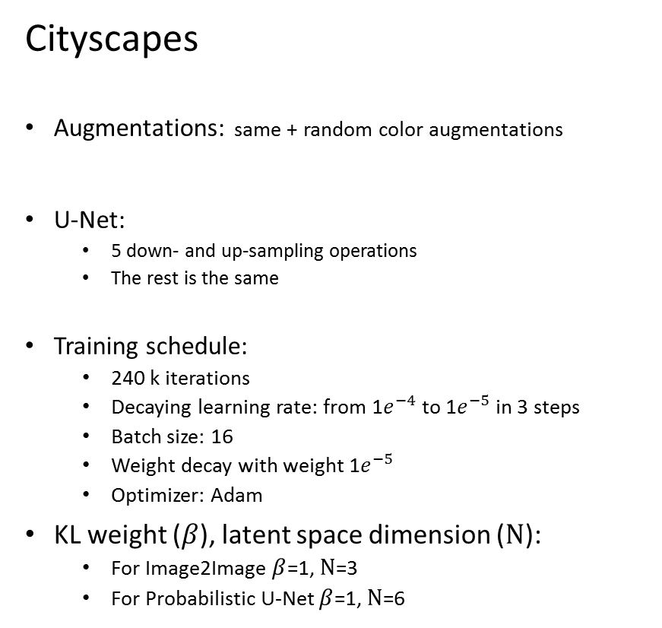
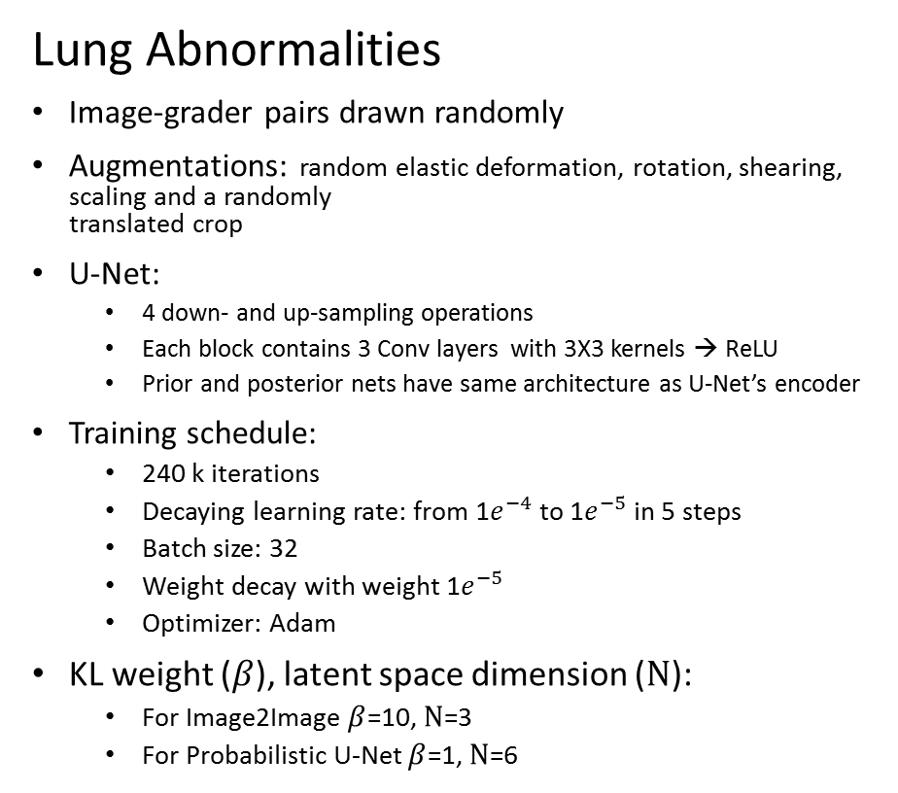
Training details
Lung Abnormalities
Image-grader pairs drawn randomly
Augmentations: random elastic deformation, rotation, shearing, scaling and a randomly translated crop
U-Net:
4 down- and up-sampling operations
Each block contains 3 Conv layers with 3X3 kernels → ReLU
Prior and posterior nets have same architecture as U-Net’s encoder
Training schedule:
240 k iterations
Decaying learning rate: from 1$e^{−4}$to 1$e^{−5}$in 5 steps
Batch size: 32
Weight decay with weight 1$e^{−5}$
Optimizer: Adam
KL weight ($β$), latent space dimension ($Ν$):
For Image2Image $β$=10, $Ν$=3
For Probabilistic U-Net $β$=1, $Ν$=6
Cityscapes
Augmentations: same + random color augmentations
U-Net:
5 down- and up-sampling operations
The rest is the same
Training schedule:
240 k iterations
Decaying learning rate: from 1$e^{−4}$to 1$e^{−5}$in 3 steps
Batch size: 16
Weight decay with weight 1$e^{−5}$
Optimizer: Adam
KL weight ($β$), latent space dimension ($Ν$):
For Image2Image $β$=1, $Ν$=3
For Probabilistic U-Net $β$=1, $Ν$=6

Slide 30
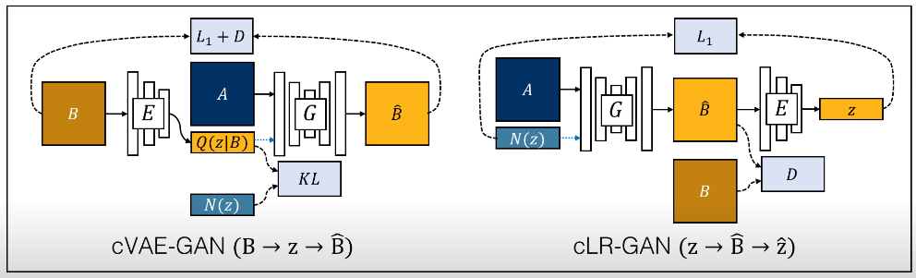
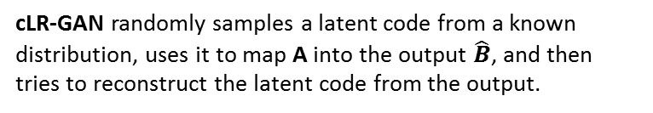
BicycleGAN
cVAE-GAN starts from a ground truth target image B and encode it into the latent space. The generator then attempts to map the input image A along with a sampled z back into the original image B.
cLR-GAN randomly samples a latent code from a known distribution, uses it to map A into the output $\hat{B}$, and then tries to reconstruct the latent code from the output.
BicycleGAN method combines constraints in both directions
Notes:
Source: https://medium.com/@poojapurabia123/image-to-image-translation-using-bicyclegan-162141f0bdf4

